Slide 1
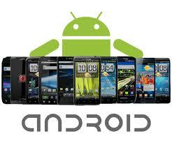

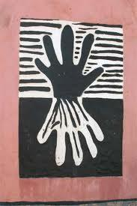


e-Commerce Mobile Application On

Slide 2

Who and What is being Presented?
Introduction : Ntsane Kolisang
Project Management Status Report : Ntsane Kolisang
Challenges and Solutions
Change Requests
Iteration 2 : Analysis : Giovanna Contu, Tsungai Makoni
Iteration 2 : Design : Abram Rankapole
Iteration 2 : Development : Ronald Chinku, Dusan Gnjatic
Next Iteration Plans : Ntsane Kolisang

Slide 3




Introduction
The Project Team :
Our Customer :
Our End User :
The Facilitator :

Slide 4
Introduction Cont…Project Objective
To project manage, develop, install, test and commission an android platform mobile application to be used by Egazini Outreach Project.

Slide 5
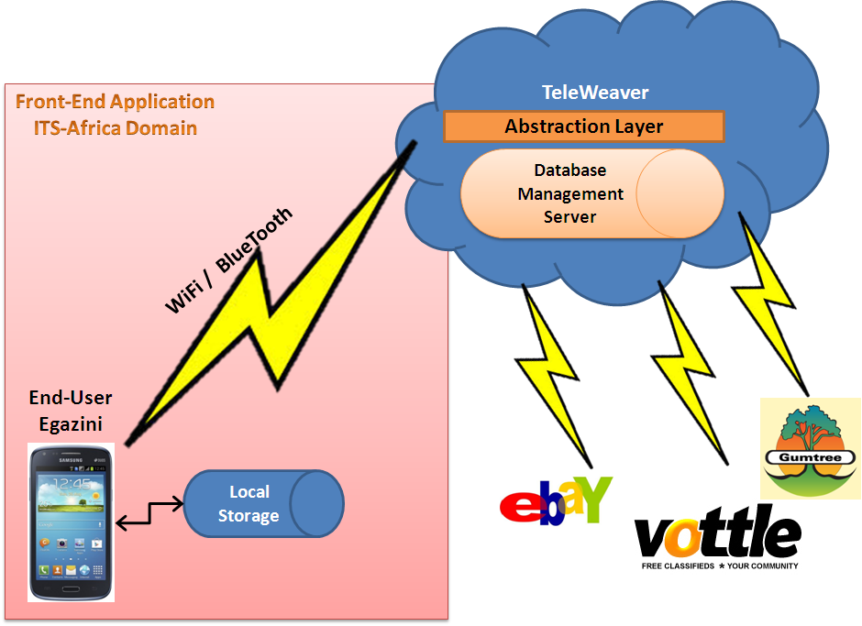
Introduction
Network Architecture Diagram - Our Operation

Slide 6
Project Management Status Report
Challenges and Solutions
Project Scope Re-definition
Develop, install, test and commission the front-end mobile application for the Reed House e-Commerce System. The application will connect to TeleWeaver using RESTful(REpresentation State Transfer) webservices.
We now had to :
Interpret activities on the administrator side.
Define business level context diagram and use cases on administrator side.
Technical Support for Basic4Android
Minimal technical support – Only one web portal available for
Technology at its infancy and Limiting (e.g. Eclipse appears to be more popular )
2 Day response time
Basic4Android Forums

Slide 7
Project Management Status Report
What Have We been Doing ?
Completion of project management documentation.
Implemented Changes and Corrections on the SRS and SDS.
Effecting Change Requests For :
Analysis – Context Diagram , Use cases and associated diagrams for the Administrator for purpose of academic interest.
Design – Use cases, Class Diagrams, Sequence diagrams , use case narratives and package diagrams
Technical Information Session with Reed House Systems on creation of Rest Client for Teleweaver.
Implemented Iteration 2 Use Cases.

Slide 8

Iteration 2 : Context Diagram
Artist
Artist
Product pictures
Picture details
Artist details
Gallery (product pictures)
Sales report
Inventory report
Profile preview
Egazini e-commerce Mobile Application
Product pictures
Product details
Picture details
Sale details
Artist details
Payment notification
Sales Details
TeleWeaver
TeleWeaver

Slide 9
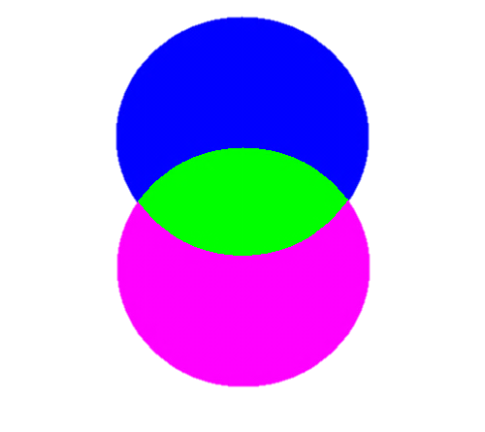
Artist
Gallery (product pictures)
Sales report
Inventory report
Profile preview
Artist
Artist
Egazini E-Commerce Mobile Application
Product pictures
Picture details
Artist details
(offline)
(offline)
TeleWeaver
(online)
TeleWeaver
Payment notification
Sales details
(online)
Access Control
Synchronisation (product pictures, artist details, picture details)
TeleWeaver
Restful Web Services
TeleWeaver
Access request
Artist
Artist
Technical access information
Login details
Sale notification (email/SMS)
Payment
TeleWeaver System
Artist
Artist
Registration details
Vendor
Product pictures
Product details
Sale details
Vendor
Buyer
Payment details
Sales details
Buyer
Sales confirmation
Products
Buyer
Buyer

Slide 10
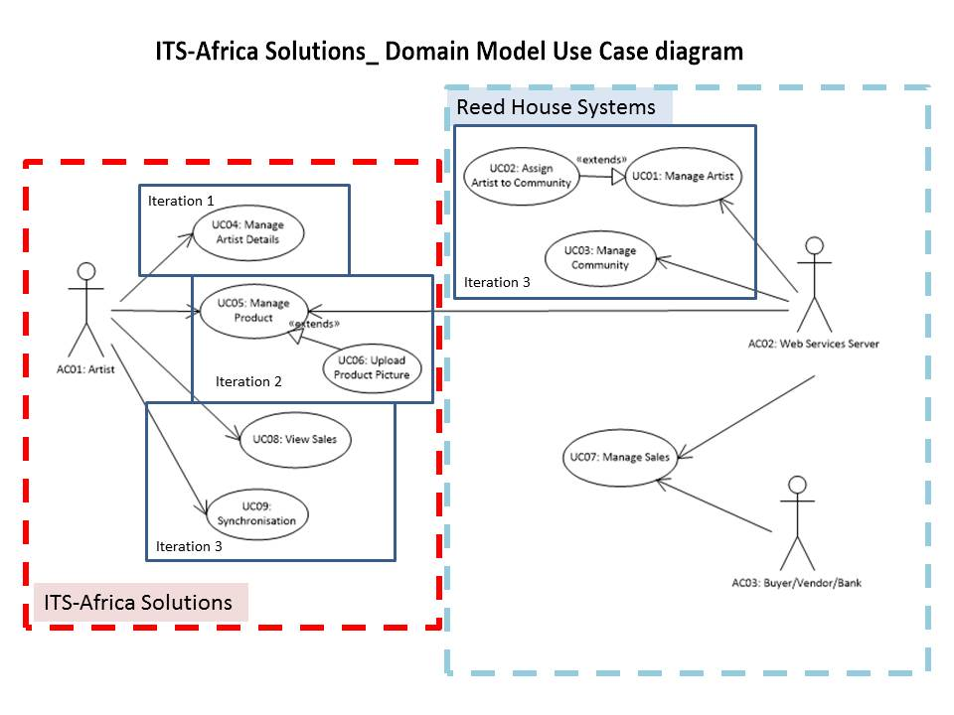
Use Case Diagram

Slide 11
Class Diagram

Slide 12
Activity Diagram: Upload a Product picture

Slide 13
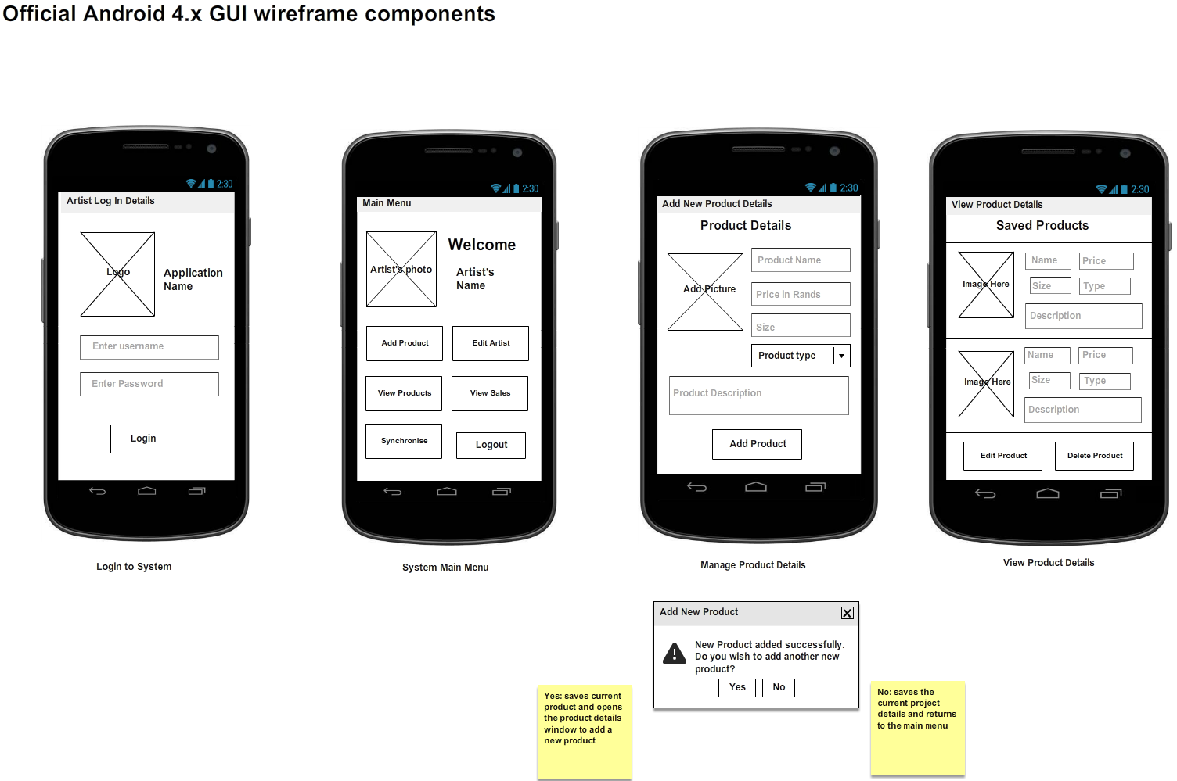
Iteration 2 : Design Interface Changes
Application name logo
(will also appear as the
logo to open the app)
Pictures medium sized,
clickable for editing and
zooming
Proposed name: “Sell my Crafts”
Page labels centred and bold
Each product separated
by break line
Will be hidden as “***” when artist starts typing for security
Drop box for product type
List of products concise, easy
to view, clear
Background colour of screens: grey-black
Buttons: purple (big buttons for visibility and
ease of use.)
Textboxes: light grey (big for usability)
Buttons and textboxes aligned (symmetry)
Combo box: used for error prevention

Slide 14

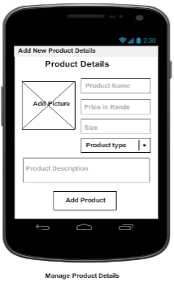

Iteration 2 : Design Storyboard for Add Product

Slide 15

Iteration 2 : Design Storyboard for View Products

Slide 16


Iteration 2 : Implementation
Platform - Basic4Android
Live Demostration

Slide 17
Next Iteration Plans
Project documentation
Correct the SRS
Correct the SDS
Review and Implement Change Requests
Iteration Use Cases
Upload Product Picture
Synchronisation to Teleweaver
View Sales

Slide 18
Q&A
Questions and Answers

